Slide 1
Cyclops Project
Data Science Division, Statistics Canada
Presentation 3 – November 18, 2019

Slide 2
Scope Revisited
Priorities of items after the meeting with HC inspectors:
NPN number: if exists they look that up in the LNHPD to find the list of ingredients, recommended dosage, etc. If NPN does not exist, they find the company name/brand name and look those up in the LNHPD
If the product is available on LNHPD, they cross-reference all the ingredients on the labels with the ingredients on LNHPD to make sure that none of the ingredients are prohibited (as in schedule 2, i.e. excluded NHP substances), otherwise they look for at least one substance in schedule 1 (natural substances).
If the product is not available on LNHPD, they cross-reference all the ingredients in the NHP ingredient and make sure that there are no controlled or biological drug substances are among the ingredients,
Once they are done with the ingredients and the product has not failed up to that point, they will go to the claim and check the wording to make sure that it does not include any disease associated to prohibitive words (cure cancer, etc) and if not then they finally check the cosmetic document and look for the compliant claims,
all the above steps are passed, then the product is NHP and compliant.

Slide 3
Flow Chart
Image | Database & guidelines | Compliance checks
IMAGE(S)
Validate Label against Product License
Is the registered NHP
Active and displays NPN?
Annotate
API Calls
Via LNHPD_ID key
Is displayed claim consistent with Product Purpose database?
NPN/Product/Company Image
Product Purpose Entry
Claim Image
If product is registered…
Is displayed ingredients consistent with medical LNHP ingredients database?
Product Medicinal Ingredients Entry
Ingredients Image
Recognize Text
Compare with…
Does the claim follow Guidelines for Cosmetic Advertising & Labelling Claims?
NPN/Product/Company text
Claim Rules
Claim Text
Check with…
If product is a NHP…
Substance & Drug Details (Schedule)
Describe substances that are not in Schedule 1, if any.
Ingredients Text

Slide 4
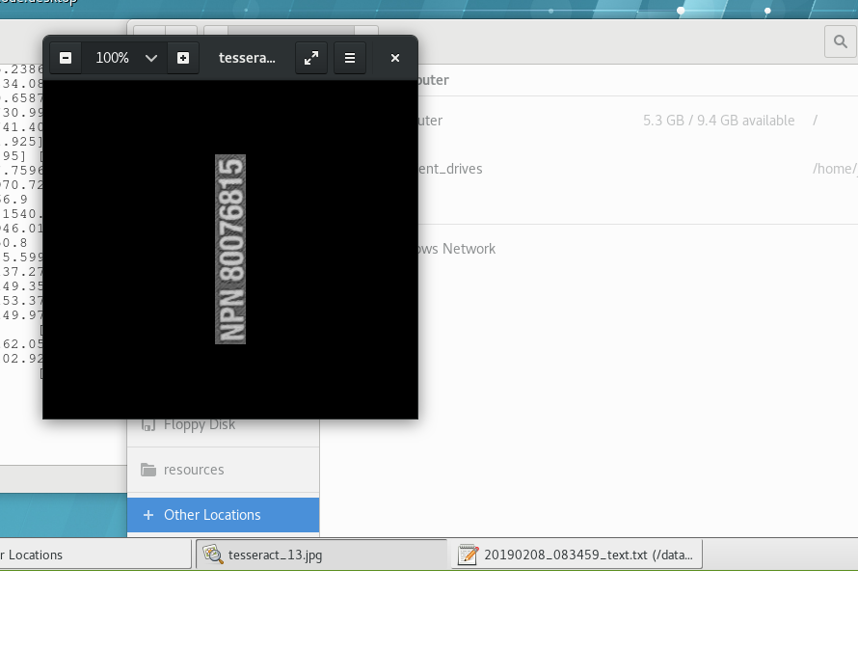
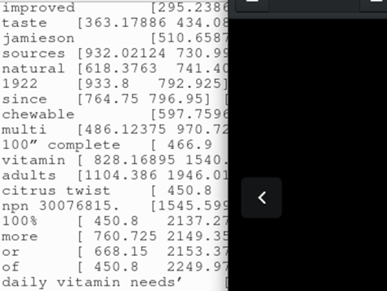
Update on the OCR – Rotating vertical text
NPN are the first key item to catch, but are frequently vertically rotated
The image cannot auto-rotate vertical words, thus used the tesseract confidence score.
Recognizing rotated images outputs short gibberish with low confidence score
Try rotating the vertical text to see if text is longer with higher confidence
OK. Good

Slide 5
Next Steps
DScD: Create the before/after OCR pipelines,
DScD: Continue with the OCR
HC: Annotate as many products as possible (real images),
HC: Cloud environment follow up,
HC: More real images from inspectors

Slide 6
Thank you!

